Slide 1
Modelling human clustering and transfer of task rules
Huadong Xiong
CCNSS 2021

Slide 2
Motivation
Real-world environments are complex and high-dimensional.
But humans solve it effortlessly and efficiently.
Hypothesis: Humans learn low-dimensional task representations to simplify the tasks.
by building abstract and behaviorally relevant representations.

Slide 3

Clustering and transfer of task rules (Colins & Frank 2016)
Learners discover structure to cluster distinct sensory events into a single latent rule set.
Transferring learned knowledge to new contexts of the same rule set.
Key findings (phenomena to model with RNN):
Within-cluster transfer of learned rules.
Generalization of clusters (learned rules) to novel contexts.
Context popularity-based priors (Chinese restaurant process).

Slide 4
Plan
Train ANNs with RL and supervised learning to perform the task in Collins & Frank 2016.
Analyze internal representations of the RNN
Whether they exhibit similarity structure across different contexts but shared the same rule set.
Examine RPEs in the RNN to determine whether they show sensitivity to hierarchical structure in a way like EEG patterns from Collins & Frank 2016.
Modify the ANNs to allow it to display a clustering prior (e.g. Chinese restaurant process) for novel contexts
Fit other ANNs directly to the behavioral data, and compare it with RNN trained to perform the task.

Slide 5
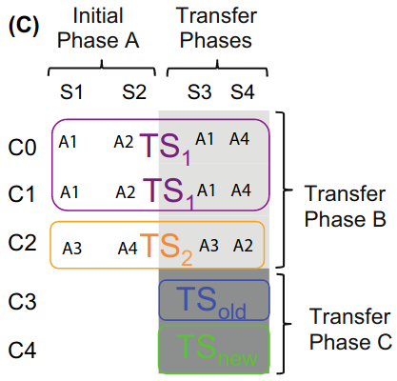

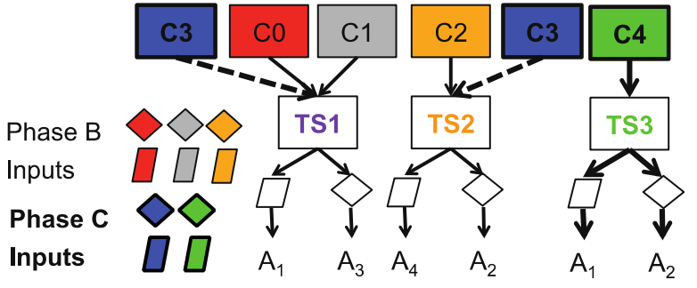
Task in Collins & Frank 2016.

Slide 6
Train ANNs with supervised learning and RL to perform the task
Architecture:
Supervised: MLP or LSTM with 1 or 2 layers.
RL: Actor-critic consists of 1 network (MLP or LSTM) with 1 or 2 layers.
Pipeline:
Phase A: Train 200 trials and converged.
Phase B: Train 200 trials and converged.
Phase C: Train 200 trials and converged.
Converged？
Supervised: 10 consecutive trials with cross-entropy loss less than 0.01.
RL: 10 consecutive trials with accuracy larger than 0.9.

Slide 7
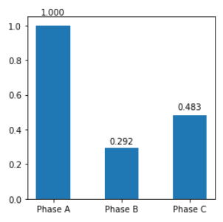
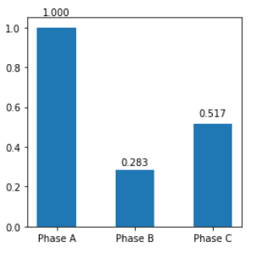
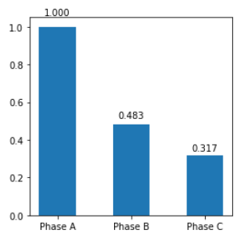
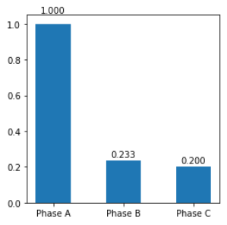
Overall transfer after initial trained on Phase A
Supervised, MLP
Supervised, LSTM
RL, MLP
RL, LSTM
Accuracy
2-layers has best performance and generalization.

Slide 8
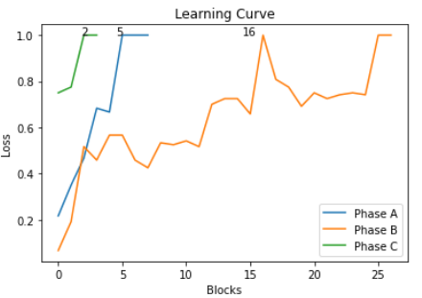
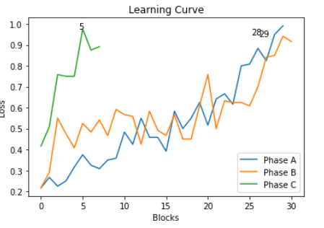
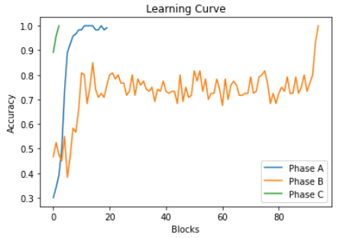
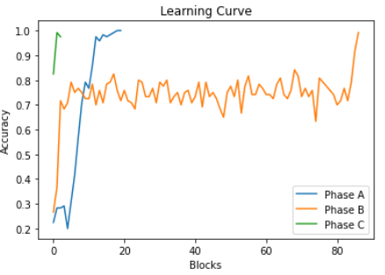
Learning curve: overall transfer
Supervised, LSTM
Supervised, MLP
RL, MLP
RL, LSTM

Slide 9
Due to:
Similar behaviors of architectures and training algorithms (supervised learning and RL)
Slow training speed of RL algorithm.
Limited time
Further analyses based on 1-layer LSTM trained by supervised learning.
And the results are the average of 100 LSTMs being random initialized.

Slide 10
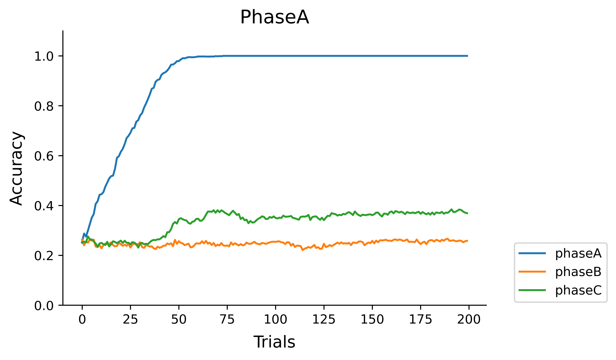
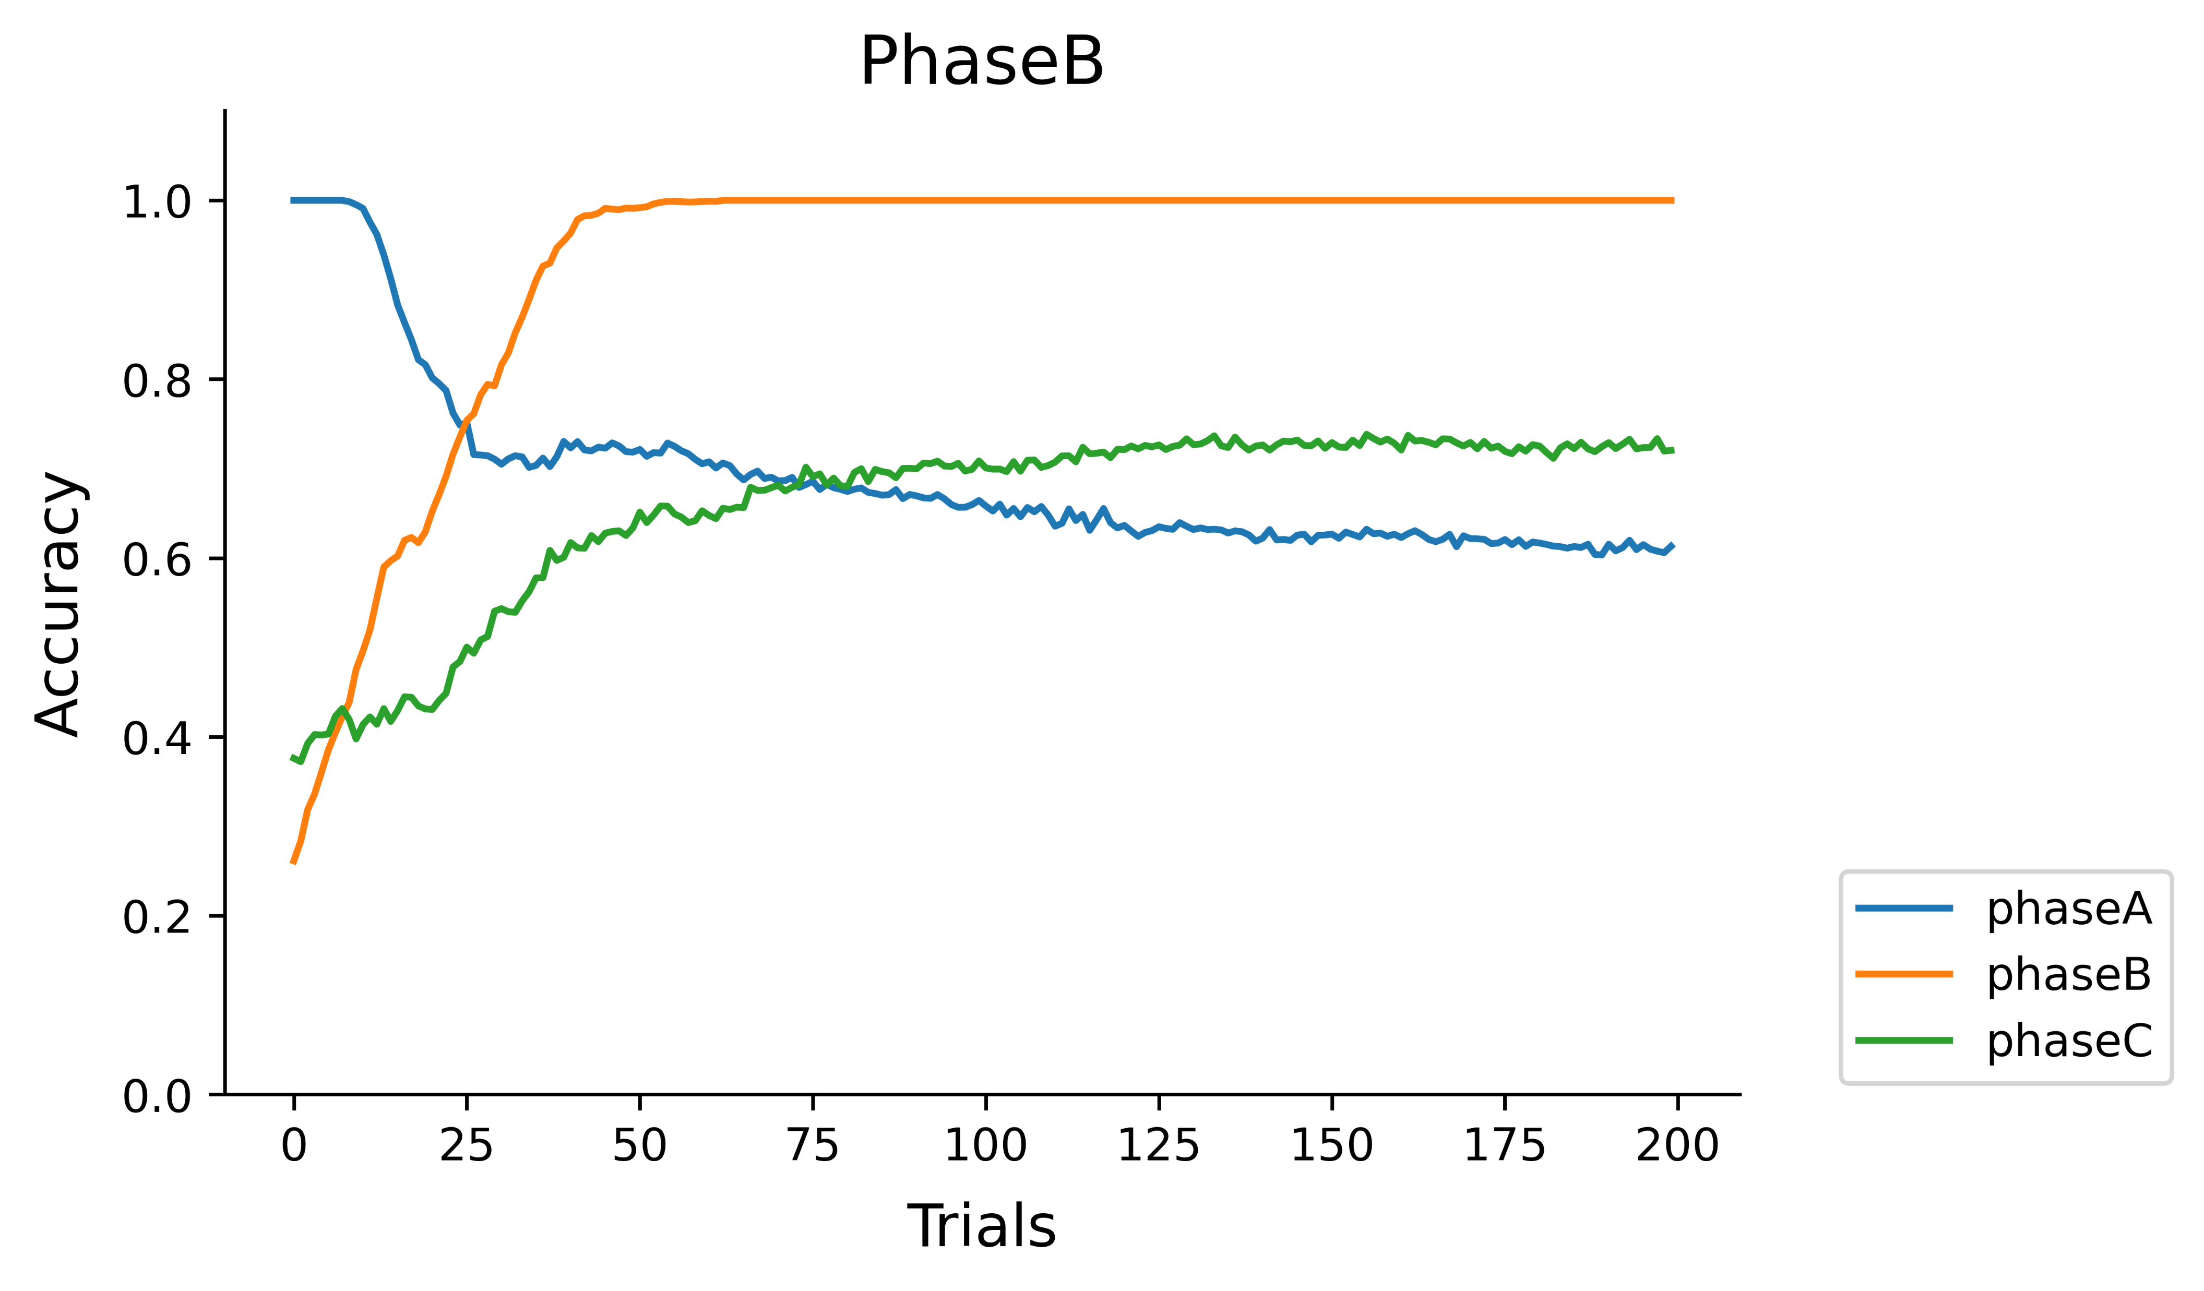
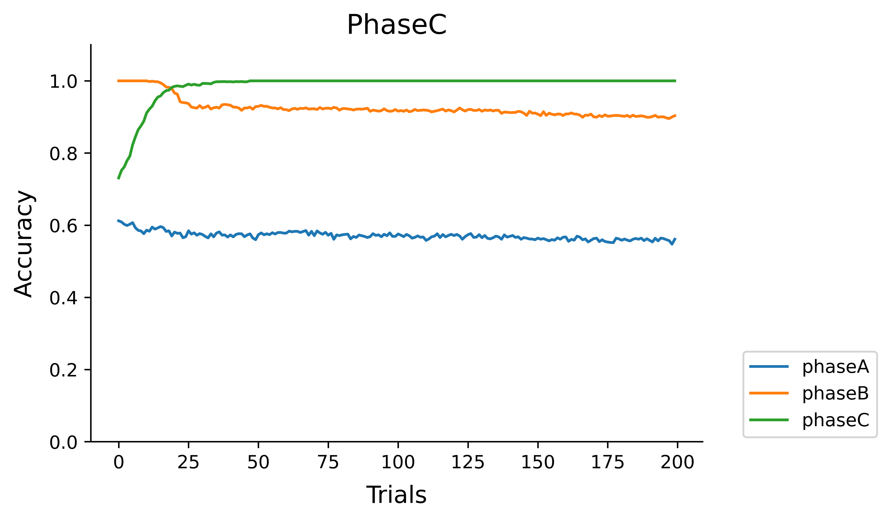
Learning Curve
Effect of per training sample on accuracy in 3 phases.

Slide 11
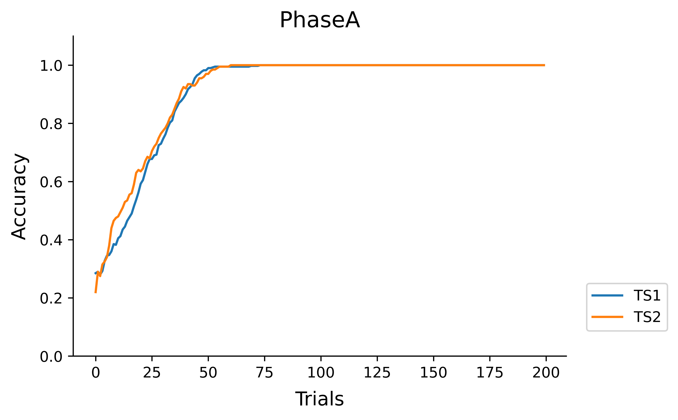
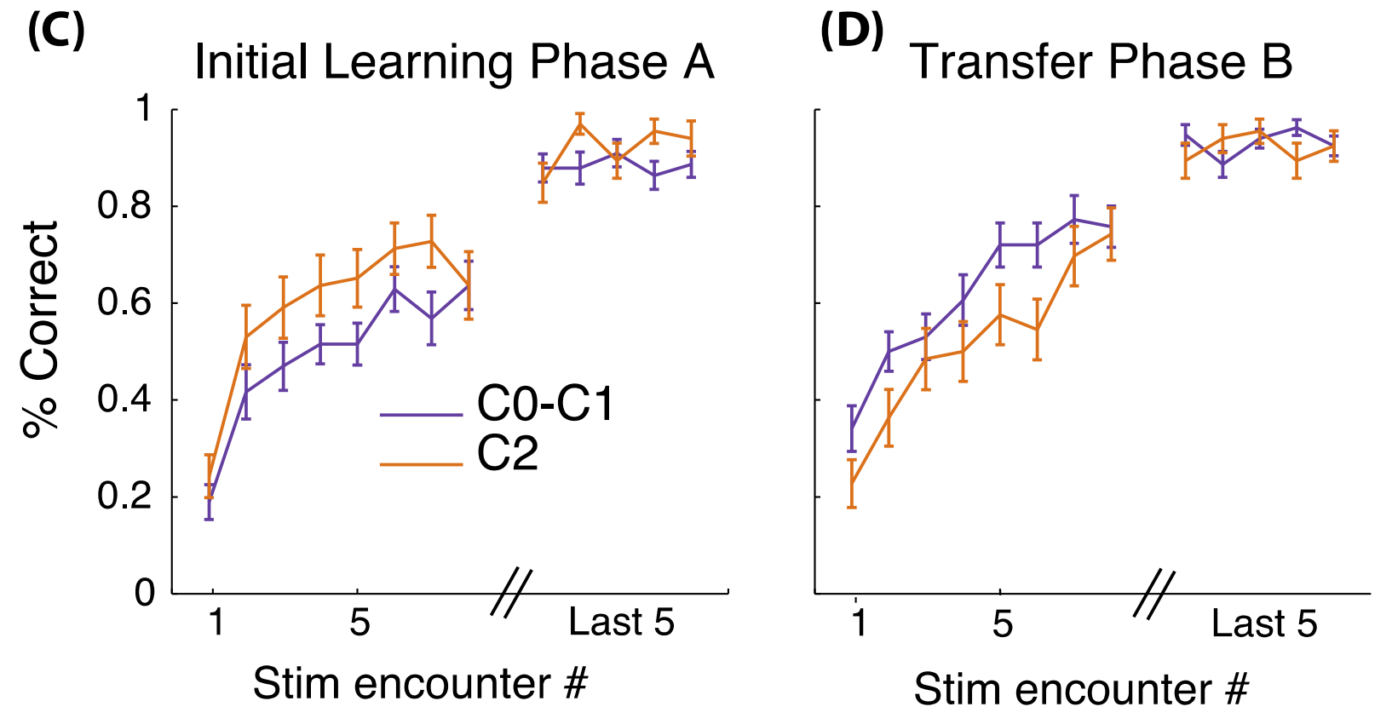
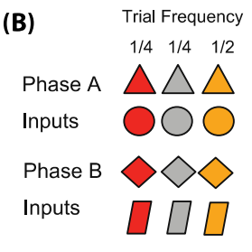
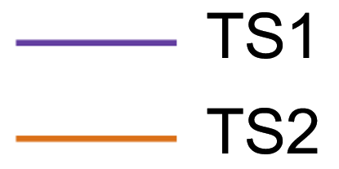

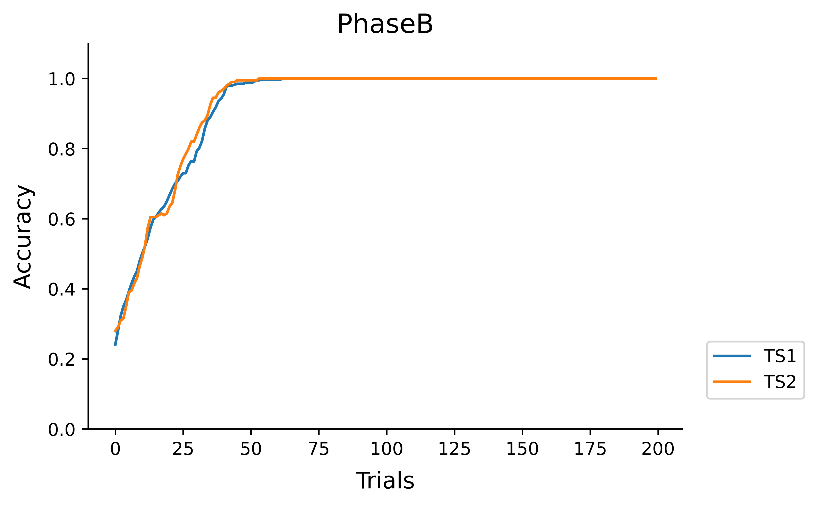
Transfer of two task sets
TS1
TS2

Slide 12
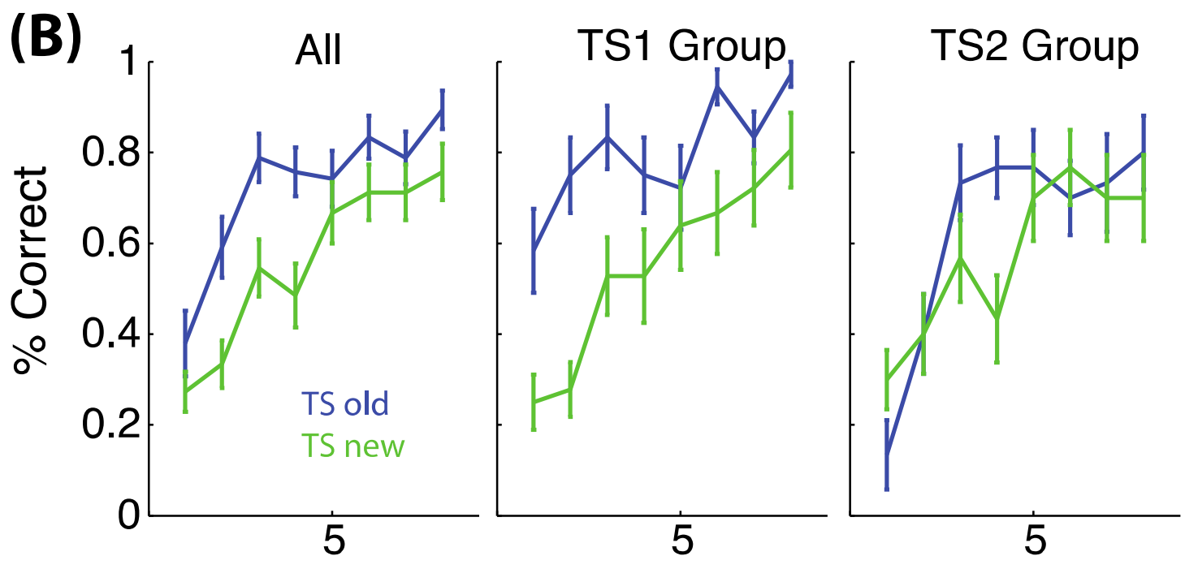
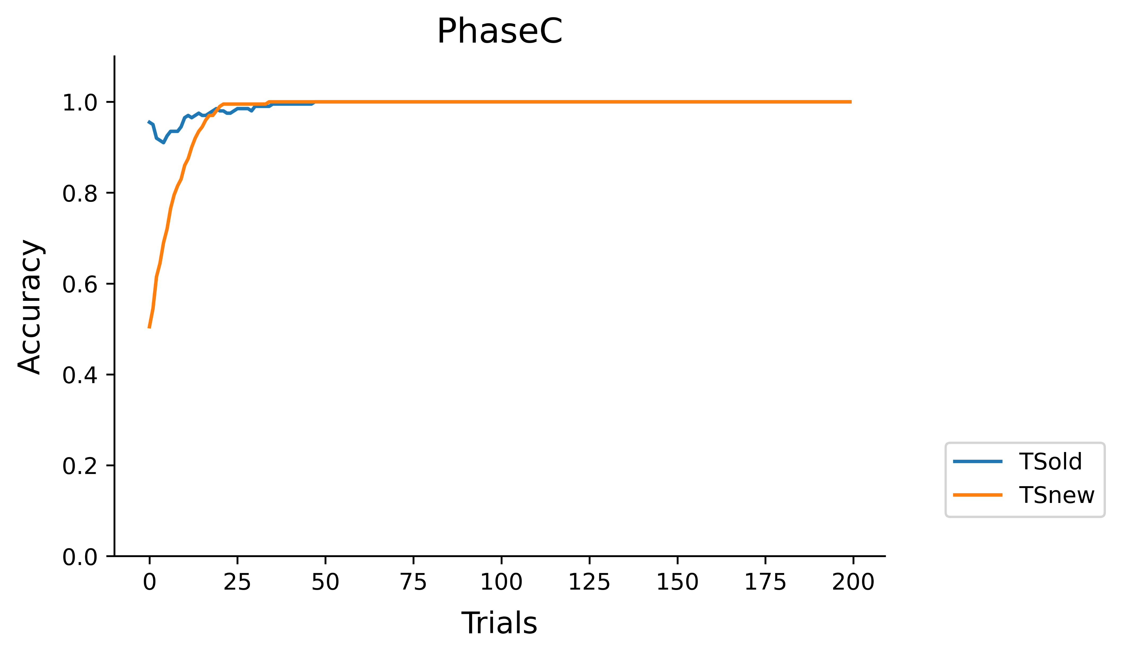

Transfer to novel contexts and clustering priors

Slide 13
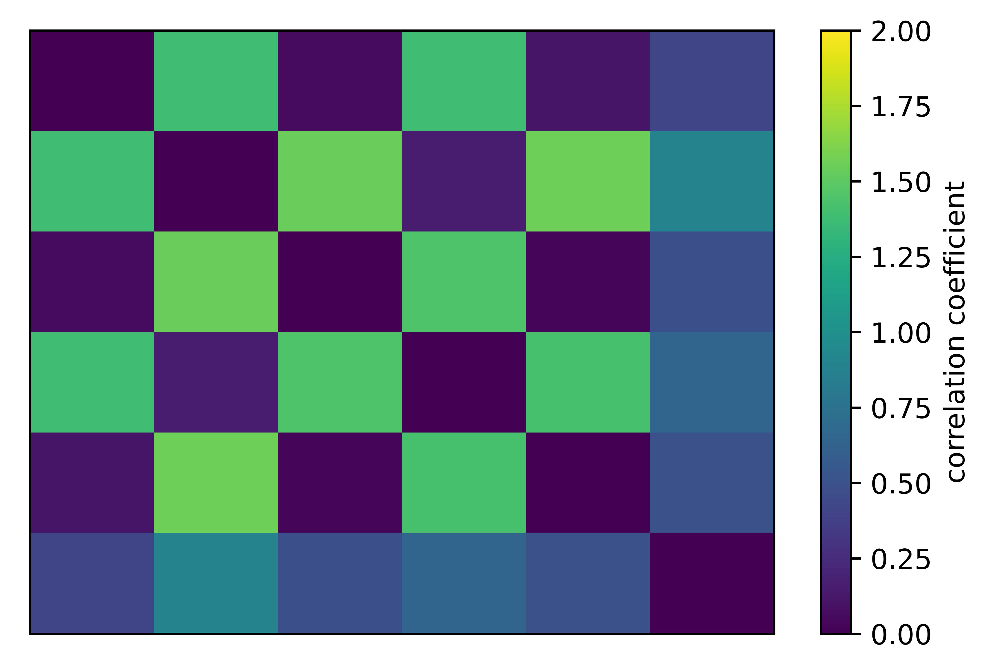
Shared representations of task sets
TS1 – PhaseA
TS2 – PhaseA
TS1 – PhaseB
TS2 – PhaseB
TSold – PhaseC
TSnew – PhaseC
TS1 – PhaseA
TS2 – PhaseA
TS1 – PhaseB
TS2 – PhaseB
TSold – PhaseC
TSnew – PhaseC

Slide 14
Future plan
Train ANNs with RL and supervised learning to perform the task in Collins & Frank 2016.
Analyze internal representations of the RNN
Whether they exhibit similarity structure across different contexts but shared the same rule set.
Examine RPEs in the RNN to determine whether they show sensitivity to hierarchical structure in a way like EEG patterns from Collins & Frank 2016.
Modify the ANNs to allow it to display a clustering prior (e.g. Chinese restaurant process) for novel contexts
Fit other ANNs directly to the behavioral data, and compare it with RNN trained to perform the task.

